Slide 1
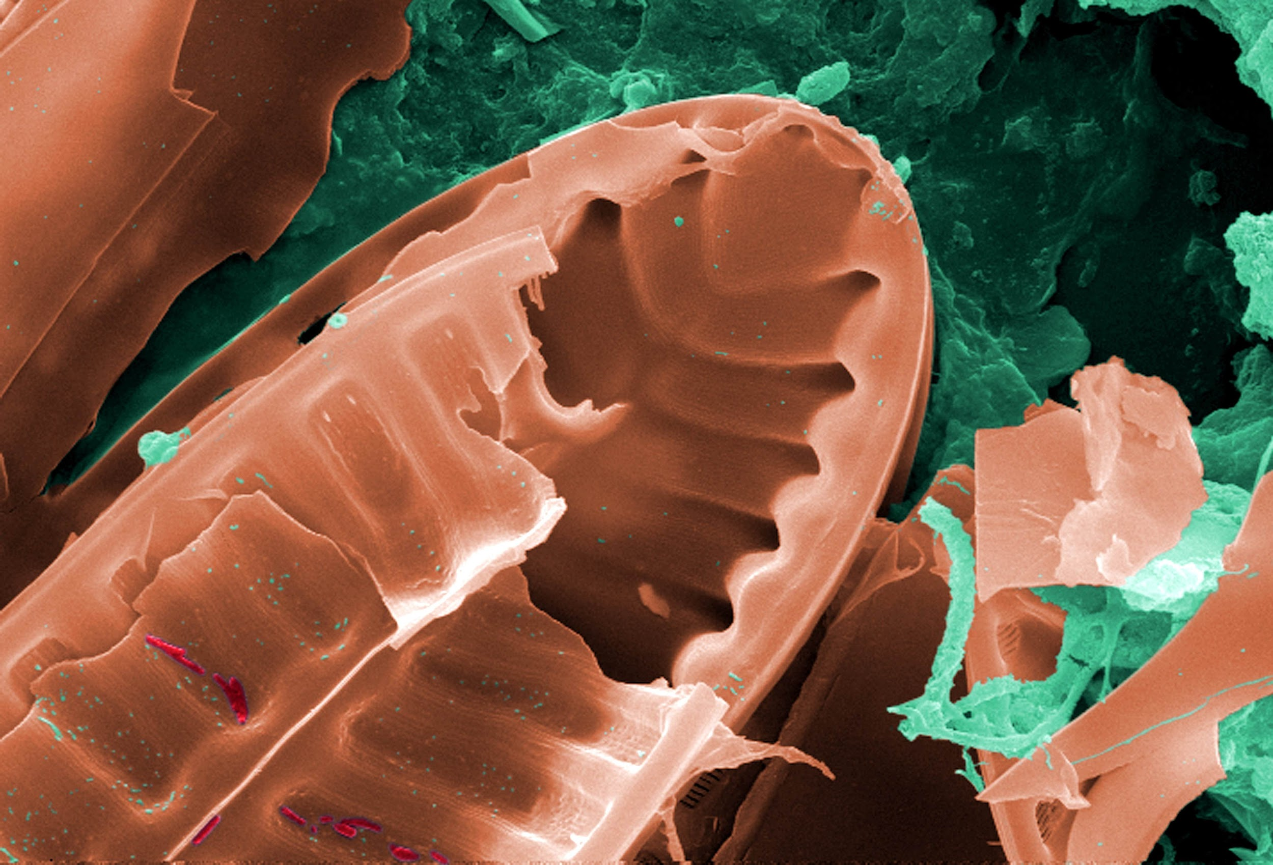
ROLE OF MICROORGANISMS
We will explain the role of microorganisms using food chains.
Notes:
Insert cover image and use transparency settings to fade image.

Slide 2
Do not delete this slide.
This slide is designed so that you can copy the prompt box you need and insert it into your slides.
This slide is hidden and will not be included when presenting your lesson.
TRACK WITH ME
CHECK FOR UNDERSTANDING
VOCABULARY
1 -
HINT
Students, remember….
READ WITH ME
TEACHER CUE
MAKE THE CONNECTION
Students, you already know….
EXTENSION

Slide 3
Write down the food chains.
Grass is eaten by rabbits which are eaten by owls.
Plankton is eaten by shrimp which are eaten by fish.
Kelp is eaten by snails which are eaten by mackerel.

Slide 4
Repeat the opposite word/phrase.
ORGANISM
LIVING THING

Slide 5
Repeat the opposite word/phrase.
CLASSIFICATION
SORTING BY CHARACTERISTICS

Slide 6
Repeat the opposite word/phrase.
VERTEBRATE
HAS A BACKBONE

Slide 7
Repeat the opposite word/phrase.
INVERTEBRATE
NO BACKBONE

Slide 8
Repeat the opposite word/phrase.
PRODUCERS
PRODUCE THEIR OWN FOOD

Slide 9
Repeat the opposite word/phrase.
PRIMARY CONSUMERS
EAT PRODUCERS

Slide 10
Repeat the opposite word/phrase.
SECONDARY CONSUMERS
EAT PRIMARY CONSUMERS

Slide 11

Using the picture below, what are some observations you could make?
Using your observations, what are some inferences you could make? Refer back to your knowledge of forces.

Slide 12
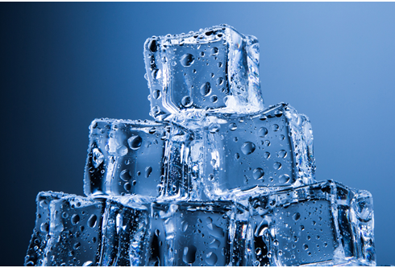
Is the example a...
SOLID
LIQUID
GAS
Why?
HINT
Think about distance between particles shape (fixed or able to be changed) movement of particles

Slide 13
We will explain the role of microorganisms using food chains.
TRACK WITH ME
READ WITH ME
We will define microorganism.
We will define detritivore.
We will explain how microorganisms and detritivores recycle energy and matter within an ecosystem.
DECLARE THE OBJECTIVE
Read the learning objective to your partner.
Notes:
Learning Objectives contain concepts (nouns, big ideas), skills (verbs, measurable behaviours) and sometimes context (restricting or targeting conditions).
●Example: Students will be able to describe the concept of density and apply it to floating and sinking.
●
Success criteria are specific measurable outcomes that if met mean that the student has met the learning objective.
Examples:
•Students will be able to compare densities of substances using mass and volume.
•Students will be able to identify whether a solid or liquid will float or sink in a liquid based on their densities.

Slide 14

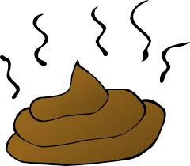
We will explain the role of microorganisms using food chains.
You already know that a food chain is a series of organisms that eat one another, so that energy and nutrients flow from one organism to the next. Food chains always start with a producer.
We classify organisms based on their position in a food chain.
Primary consumers are animals that eat the producers (e.g. plants).
Secondary consumers are animals that eat the primary consumers (e.g. lion eating an antelope).
What do you think happens to an organism's waste?

Slide 15
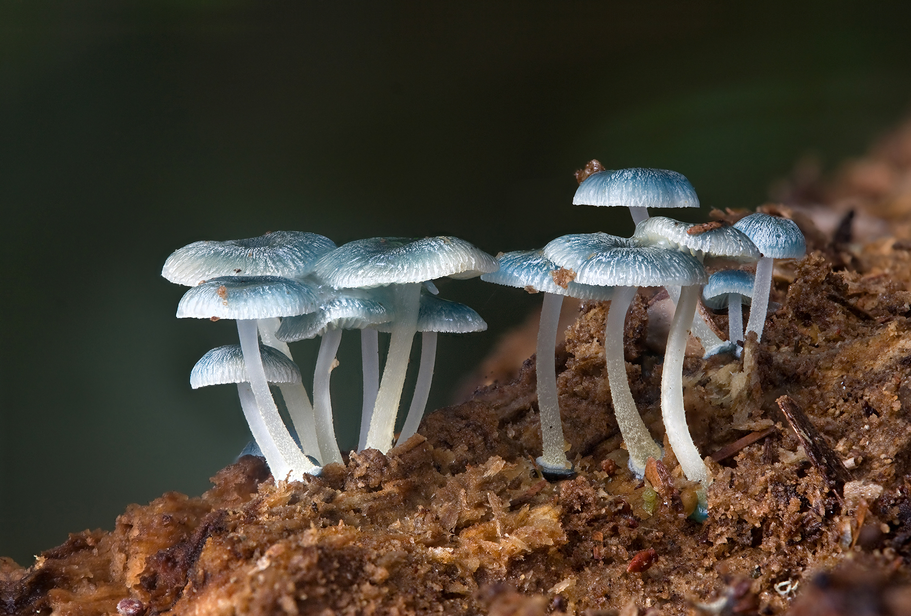
We will explain the role of microorganisms using food chains.
Inside all organisms is an enormous amount of nutrients. All organisms in a food chain end up passing these nutrients on to detritivores.
Detritivores are organisms such as bacteria, fungi and invertebrates (slugs and worms) which feed on dead material, mainly plant detritus₁ and waste material.
Detritivores such as bacteria and some fungi are microorganisms₂.
Detritivores are also known as decomposers.
CHECK FOR UNDERSTANDING
What is the role of a detritivore in the food chain? Eat living animals Feed on dead material Eat slugs and worms
VOCABULARY
1- waste or debris of any kind. 2- organisms that can only be seen with a microscope.

Slide 16
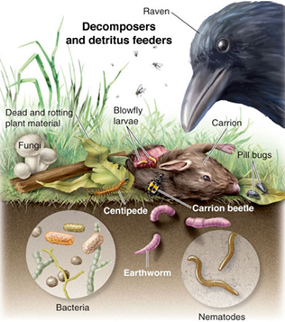
We will explain the role of microorganisms using food chains.
The detritivore gets the nutrition it needs from the dead material or waste. When another organism eats a detritivore, the nutrients once again become part of the food chain.
The nutrients that pass through the detritivore as waste end up in the soil in simpler forms.
Plant roots can then absorb the nutrients and the cycle starts again.
Detritivores recycle the energy and matter in ecosystems.
CHECK FOR UNDERSTANDING
Why is a detritivore important in a food chain?

Slide 17
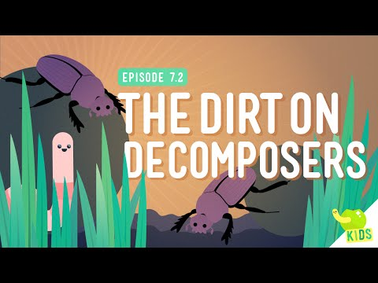
We will explain the role of microorganisms using food chains.
CHECK FOR UNDERSTANDING
How does a detritivore/decomposer recycle energy?

Slide 18
We will explain the role of microorganisms using food chains.
Producers → Primary consumers → Secondary consumers
Nutrition Detritivore Waste
CHECK FOR UNDERSTANDING
Identify the possible detritivore from food chain below. Grass → Rabbit → Fox Mushrooms Bacteria Slug All of the above. Explain your answer.
Grass → Grasshopper → Bird
Worm
In the example above the grasshopper eats the grass, the bird eats the grasshopper. The grasshopper and the bird both produce waste which the worm uses for nutrition and the worms waste feeds the soil which helps the grass grow.

Slide 19
We will explain the role of microorganisms using food chains.
HINT
Students, remember…. Detritivores are organisms such as bacteria, fungi and invertebrates (slugs and worms) which feed on dead organic material, mainly plant detritus and wastes. Arrows represent the transfer of energy in a food chain.
Write down the food chains and add in a detritivore.
Grass is eaten by a grasshopper which is eaten by a kookaburra. The kookaburra and grasshopper both produce waste which is used as nutrition by bacteria.
Apple is eaten by a mouse, mouse is eaten by eagle. The eagle and the mouse produce wastes which are broken down by worms.
A rabbit eats the grass and dies. It’s dead remains are decomposed by detritivores.

Slide 20
We will explain the role of microorganisms using food chains.
Detritivores recycle important nutrients in our ecosystem.
By the detritivores using the other organisms wastes as nutrition, it prevents the dead organisms from piling up.
Mushrooms (fungi) are detritivores. They get the nutrients they need by feeding on dead things, such as rotting logs.
CHECK FOR UNDERSTANDING
What is the role of a detritivore in the food chain?

Slide 21
We will explain the role of microorganisms using food chains.
Detritivores are organisms such as bacteria, fungi and invertebrates (slugs and worms) which feed on dead material, mainly plant detritus₁ and waste material.
Detritivores such as bacteria and some fungi are microorganisms₂.
When another organism eats a detritivore, the nutrients once again become part of the food chain.
CHECK FOR UNDERSTANDING
What is a microorganism?
VOCABULARY
1- waste or debris of any kind. 2- organisms that can only be seen with a microscope.

Slide 22
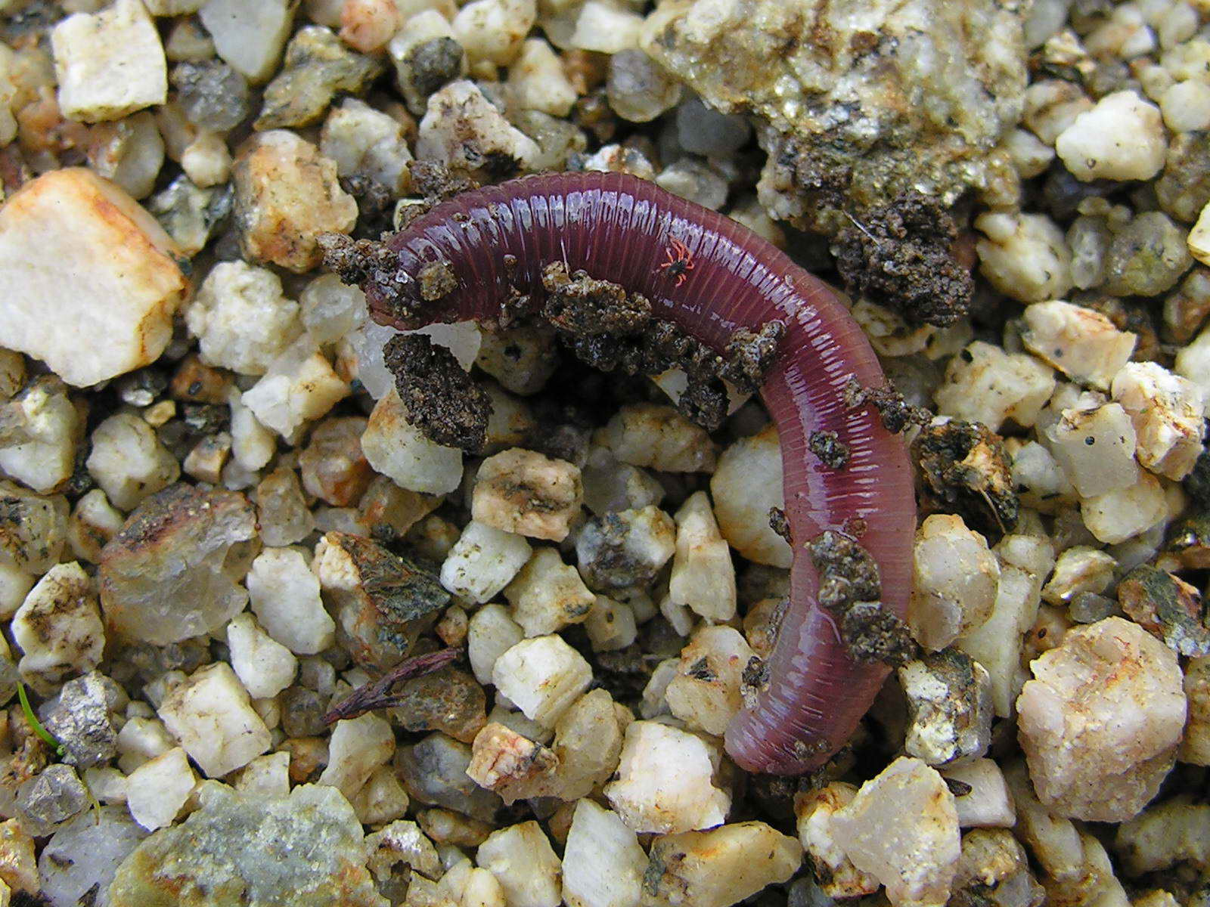
We will explain the role of microorganisms using food chains.
In your workbook answer the following questions using full sentence answers.
HINT
Students, remember…. A microorganism is an organism that can only be seen with a microscope. Detritivores are organisms such as bacteria, fungi and invertebrates (slugs and worms) which feed on dead organic material, mainly plant detritus and wastes.
What is a microorganism?
What is a detritivore?
How does a detritivore help recycle energy in our ecosystem?
Draw two examples of food chains that include a detritivore.
Notes:
Please include tasks/questions here rather than just referring to a worksheet. This will save on photocopying and facilitate sharing with other schools.
Try and build tasks/questions which escalate through Bloom’s Taxonomy. This will help with differentiation.

Slide 23
We will explain the role of microorganisms using food chains.
We will define microorganism.
We will define detritivore.
We will explain how microorganisms and detritivores recycle energy and matter within an ecosystem.
CHECK FOR UNDERSTANDING
Check Success Criteria.

